Slide 1
Lecture 3: Kalman filter
April 5, 2016

Slide 2

Directed random walk
$$x_{t+1}=x_{t}+ε_{t}$$
$$ε_{t}\sim Normal(α,σ_{x}^{2})$$
$$log⁡(y_{t})\sim Normal(x_{t},σ_{y}^{2})$$
Time-series follows a random-walk with a trend $α$

Slide 3
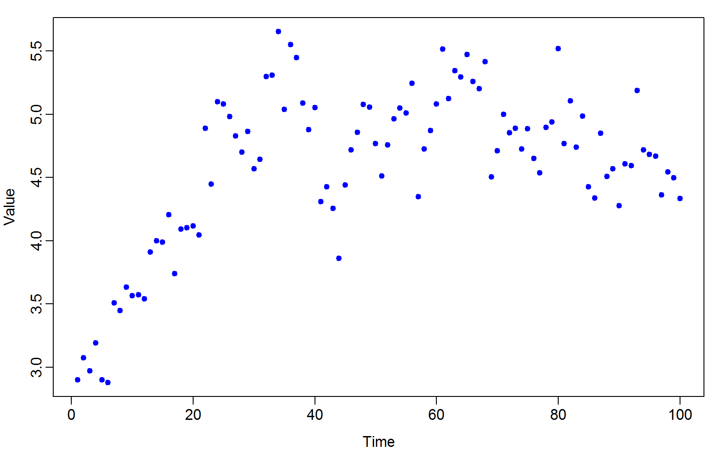
Data set

Slide 4
Questions
Is there evidence of density dependence?
If yes, what is the expected equilibrium?
What is the stationary distribution?
Variance
How “stable” is the model
Reactivitiy
Resilience
Resistence

Slide 5
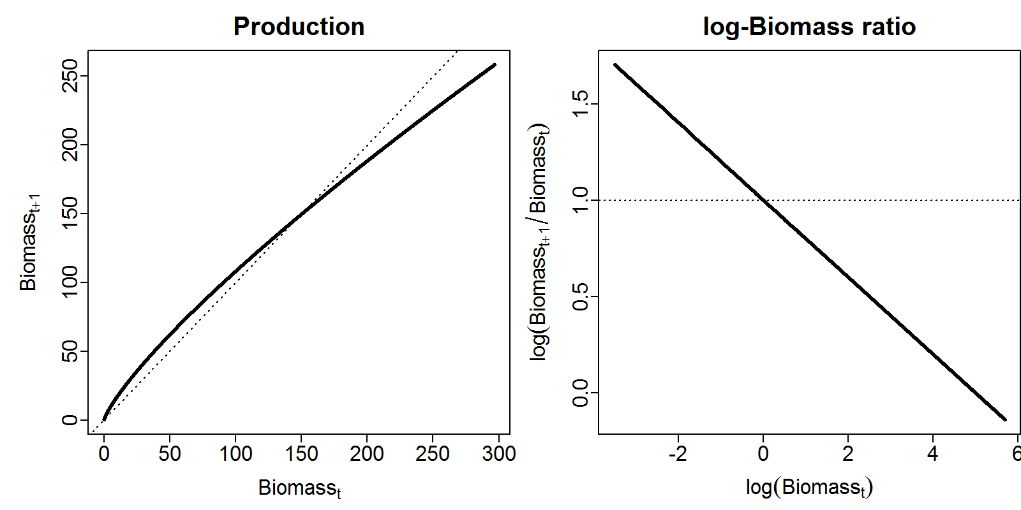

Gompertz model
$$d_{t+1}=d_{t}\exp\left(α−β{log⁡(d}_{t})+ε_{t}\right)$$
$$ε_{t}\sim Normal(0,σ_{d}^{2})$$
$$log⁡(b_{t})\sim Normal\left(log⁡(d_{t}),σ_{b}^{2}\right)$$

Slide 6
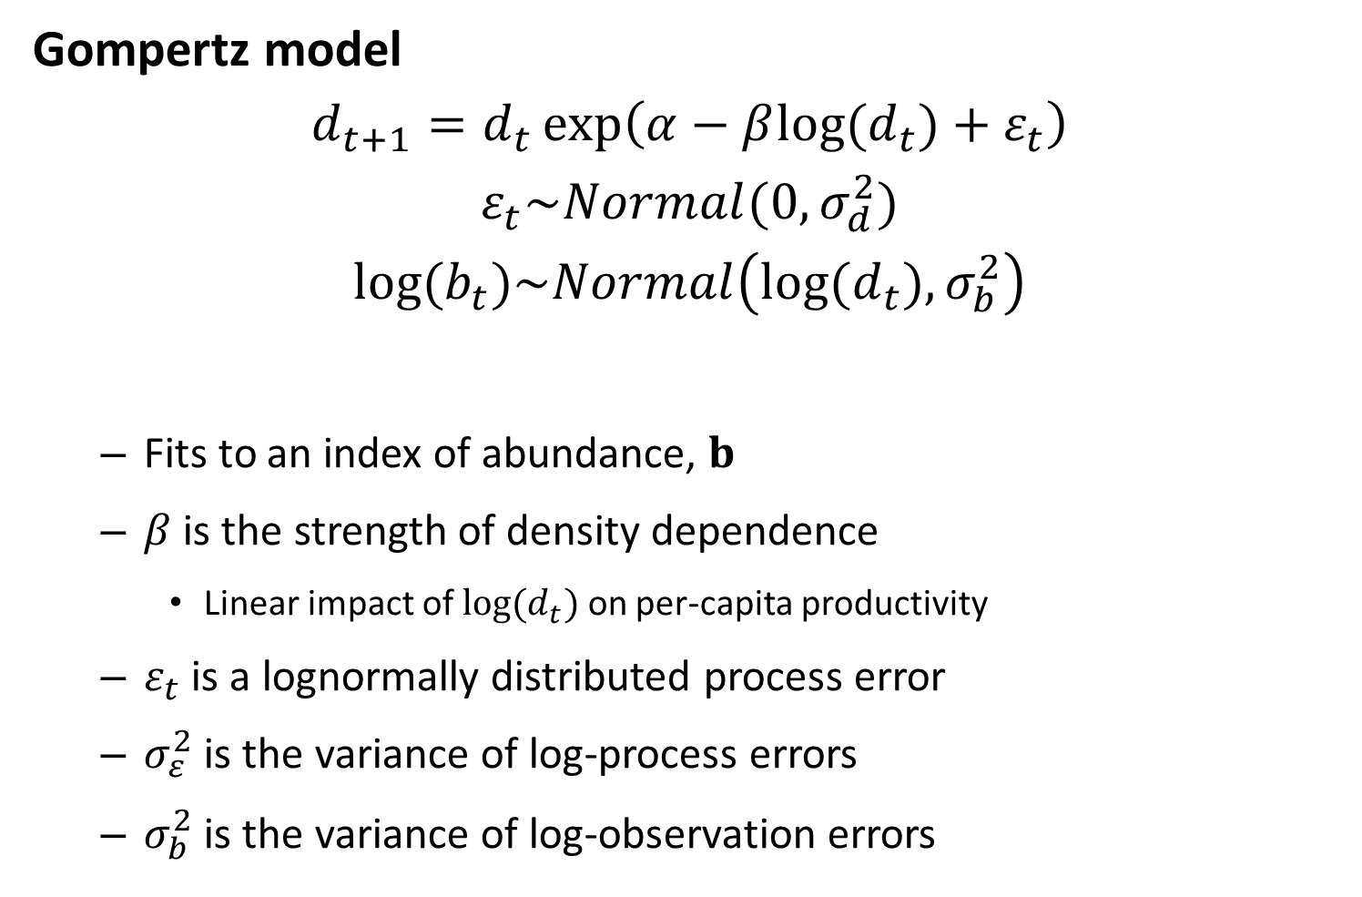
Gompertz model
$$d_{t+1}=d_{t}\exp\left(α−β{log⁡(d}_{t})+ε_{t}\right)$$
$$ε_{t}\sim Normal(0,σ_{d}^{2})$$
$$log⁡(b_{t})\sim Normal\left(log⁡(d_{t}),σ_{b}^{2}\right)$$
Fits to an index of abundance, $b$
$β$ is the strength of density dependence
Linear impact of ${log⁡(d}_{t})$ on per-capita productivity
$ε_{t}$ is a lognormally distributed process error
$σ_{ε}^{2}$ is the variance of log-process errors
$σ_{b}^{2}$ is the variance of log-observation errors

Slide 7
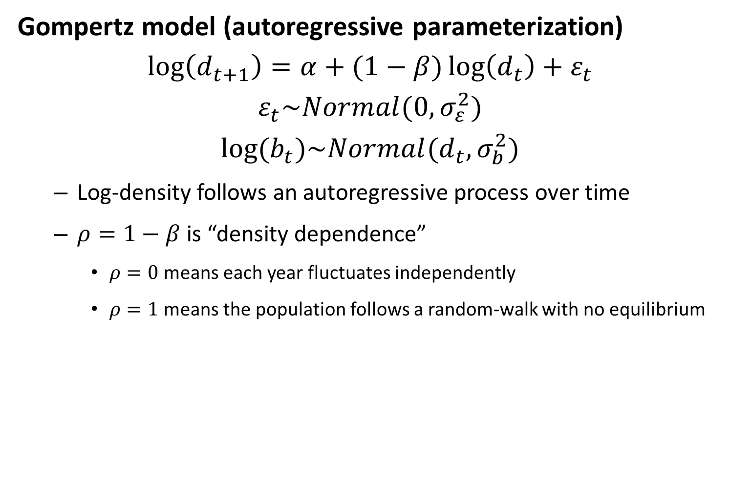
Gompertz model (autoregressive parameterization)
$$\log\left(d_{t+1}\right)=α+(1−β)\log\left(d_{t}\right)+ε_{t}$$
$$ε_{t}\sim Normal(0,σ_{ε}^{2})$$
$$log⁡(b_{t})\sim Normal(d_{t},σ_{b}^{2})$$
Log-density follows an autoregressive process over time
$ρ=1−β$ is “density dependence”
$ρ=0$ means each year fluctuates independently
$ρ=1$ means the population follows a random-walk with no equilibrium

Slide 8
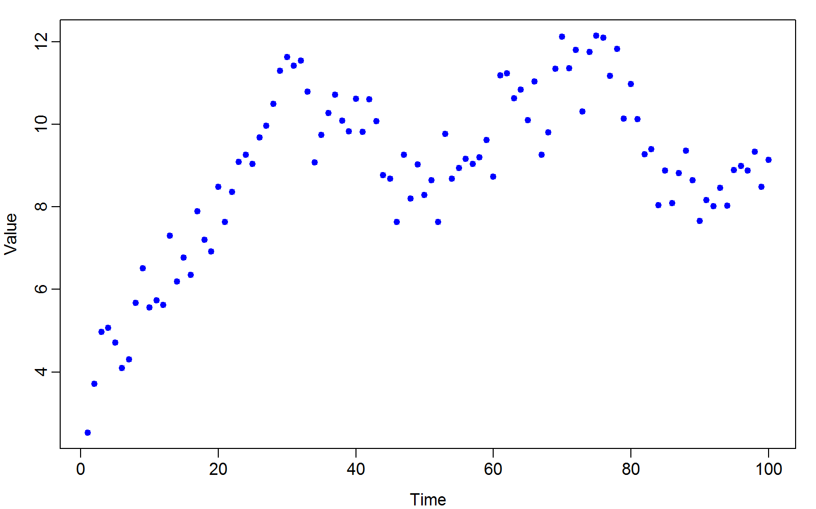
Gompertz model (autoregressive parameterization)

Slide 9
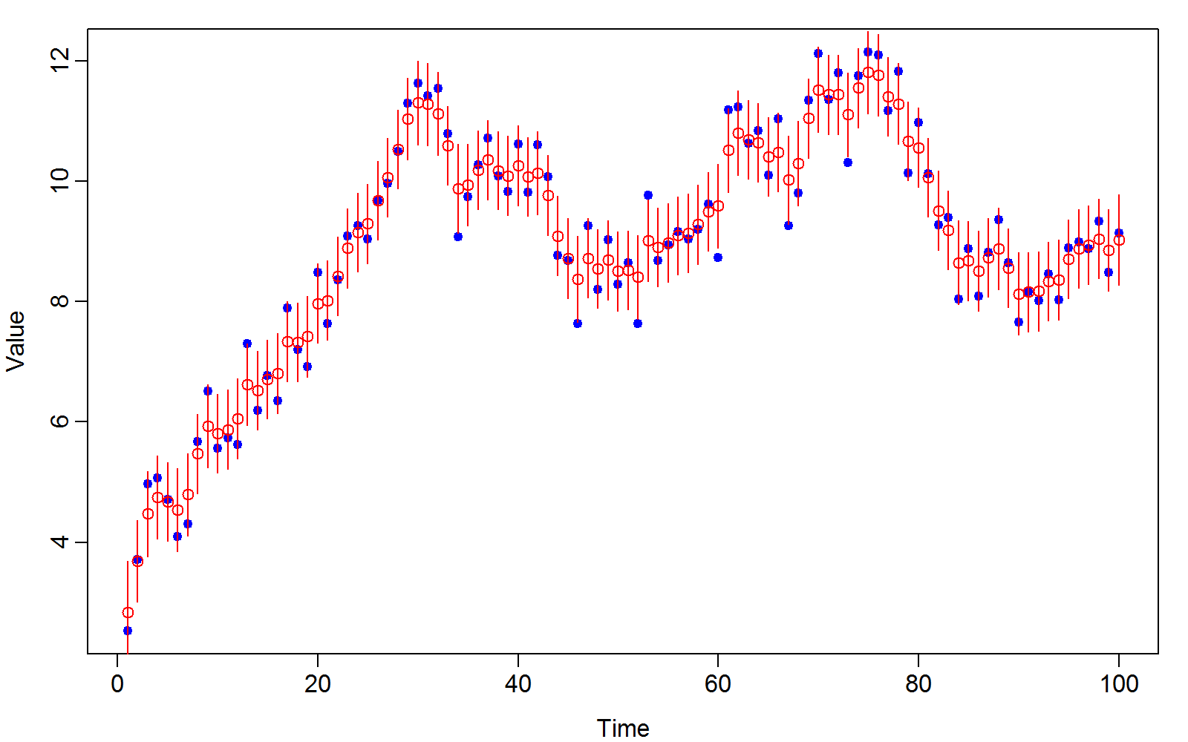
Gompertz model (autoregressive parameterization)

Slide 10
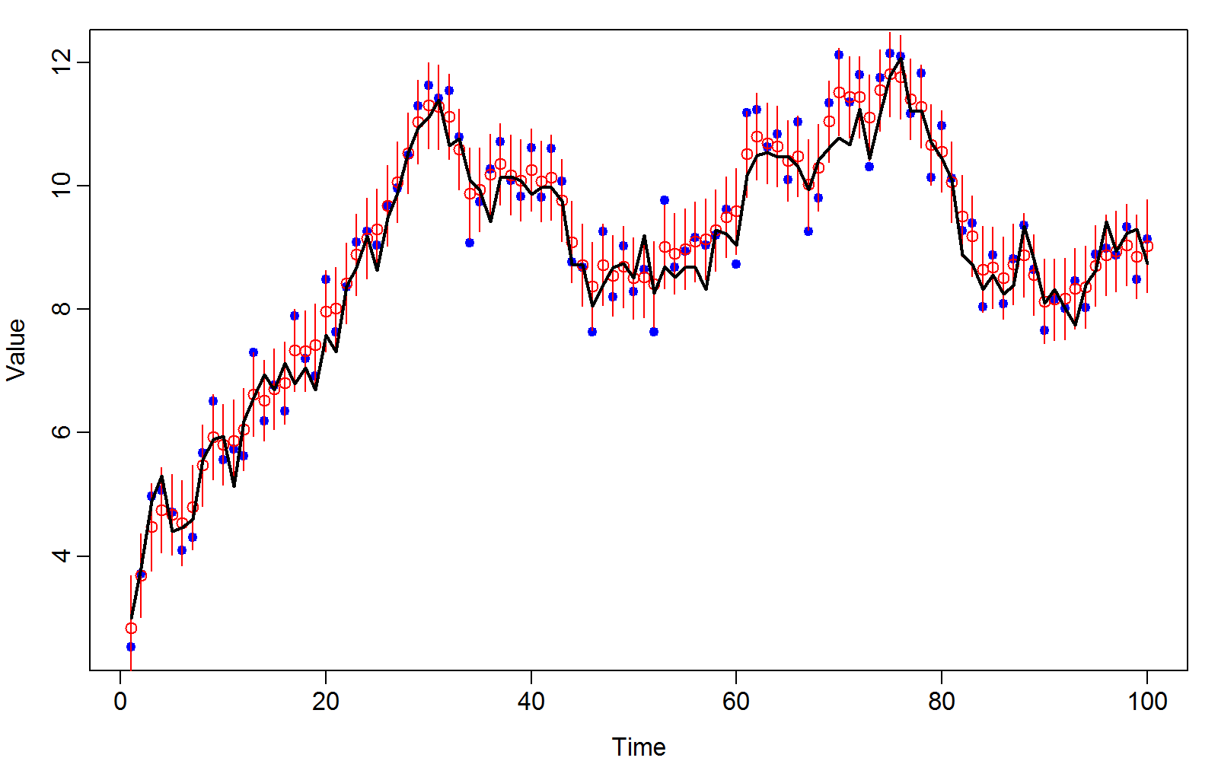
Gompertz model (autoregressive parameterization)

Slide 11
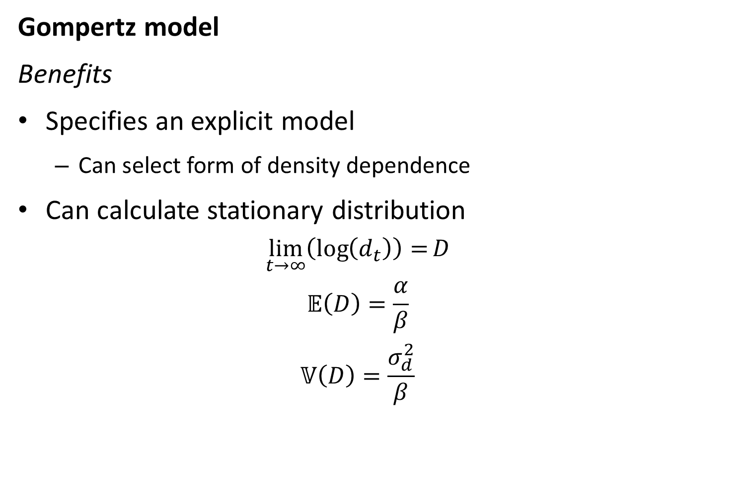
Gompertz model
Benefits
Specifies an explicit model
Can select form of density dependence
Can calculate stationary distribution
$$\lim_{t→∞}\left(\log\left(d_{t}\right)\right)=D$$
$$𝔼\left(D\right)=\frac{α}{β}$$
$$𝕍\left(D\right)=\frac{σ_{d}^{2}}{β}$$

